Slide 1
Prediction of store sales
Mini project 1
Submitted by:
Sumit

Slide 2
Introduction
The success of any retail store depends upon its sales. More the sales made, more is the revenue.
With a good customer service and care, the customer too enjoys a good shopping experience.
This will lead to more in-flow of customers, opening more store branches across a city / country.
To enable this, store owners rely heavily on past data to predict future sales.

Slide 3

Problem statement
Our main goal is to predict sales of store on the basis of past data to opening more store branches across a city / country..
What are the key factors that can increase their sales and what changes could be made to the product or store’s characteristics to increase the sales.
In order to achieve this goal, a predictive model can be built to find out the sales for every store.

Slide 4

Methodology
Read the data.
Summarize the data.
Data structure (Type of data).
Data Visualization.
Data preprocessing
Model building.

Slide 5
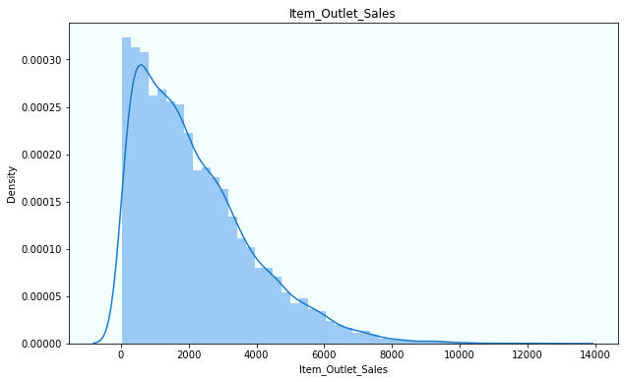
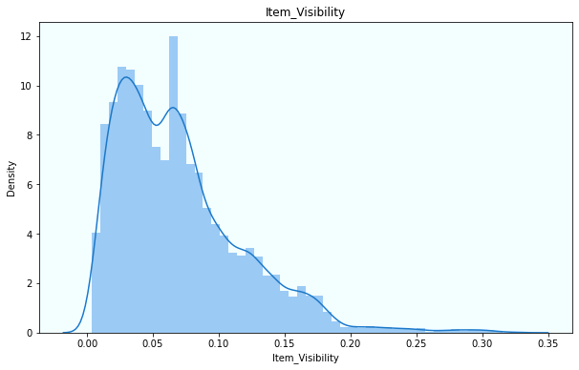
EDA(Exploratory data analysis)
Items outlet sales and item visibility
Items outlet sales and items visibility data more toward right skewed.
We can see visibility of many item have very low that affect the sales of items.

Slide 6
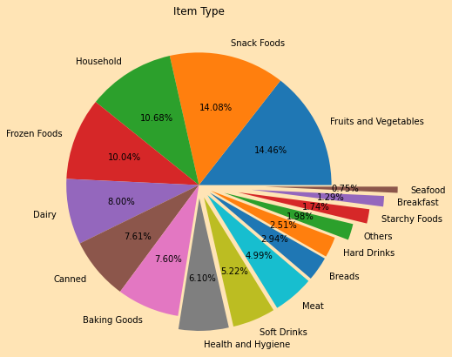
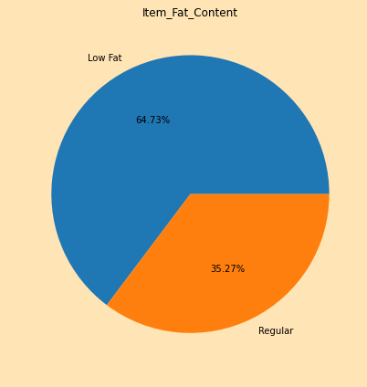
Items types and item fat content
Item type contain max sales of fruits and vegetable, snack foods.
Item types which contain low fat has sales more then regular one.
Means items which are for daily use and contain low fat have max sales.

Slide 7
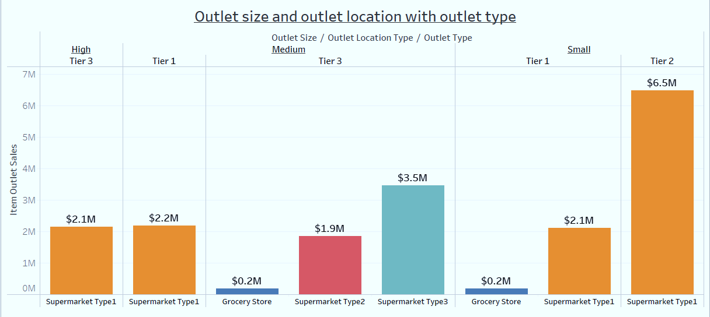
Outlet size and Outlet location with outlet type
We have max sale with supermarket type1 at tier 2 location with small size of outlet types.

Slide 8
Shops which have highest sales
Shops which are of small size have maximum sale.
Tier2 shops location type have maximum sales.
Supermarket type 1 shops contain maximum sales.
These shops contain maximum sales of daily items like fruits and vegetables, snack foods, household.
Hence for opening new shops if these condition are to be consider then for sure we will have a good sales and good profit.

Slide 9
Regression Models
Linear Regression
Decision Tree Regression
Random-Forest Regression
AdaBoost Regression

Slide 10
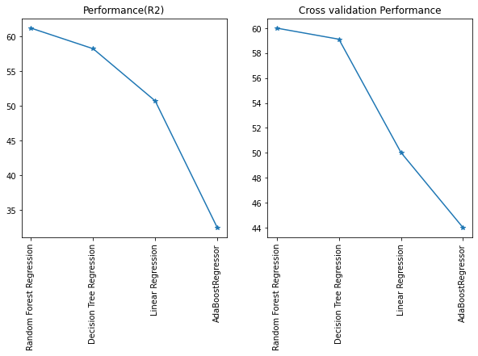
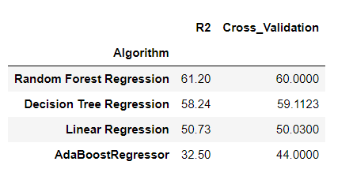
Model performance
By evaluating models by cross validation also Random forest regression algorithm perform well to predict the sales of a store.

Slide 11
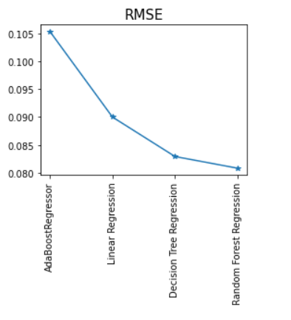
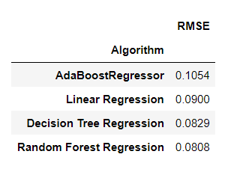
Modals residual
As we can clearly see random forest regression has the minimum residual. Its clearly show model perform well to predict sales.

Slide 12
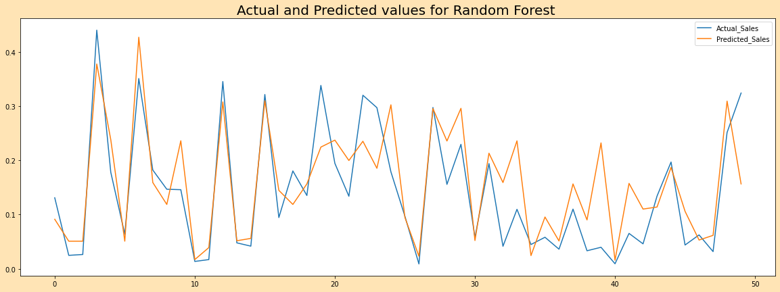
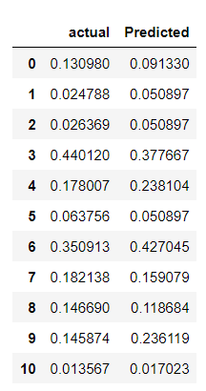
actual vs Predicted
Prediction values of store sales with actual values of store sale.
Random forest regression predict similar values to actual values.

Slide 13
Conclusion
By comparing all the models with their RMSE values and R-squared values we find that Random Forest Regressor is best model which give better predictions for store sales. So, we consider Random Forest Regressor as the best model for this dataset.
As concerned with sales, Many Items have low visibility (placed them in front to maximize the sale of that product).
Keep daily products more in the store to make more sales like fruits and vegies, snacks foods, household things etc.
Grocery Stores which have low sales can move to the tier 2 for the high sales.
Do some advertisement of the products which may increase the sales.
Place some discounts templates that attracts the customers.

Slide 14

Thank you

